Slide 1
Introduction to Machine Learning and Control for Building Energy Systems
Ján Drgoňa
Associate Professor @ CaSE & ROSEI

Slide 2
Course Syllabus
Week 1: Introduction to Building Energy Systems
Week 2: HVAC systems and heat transfer modeling
Week 3: Dynamical systems fundamentals
Week 4: Control systems fundamentals
Week 5: Machine learning fundamentals - with HVAC load forecasting example
Week 6: System identification - with thermal dynamics modeling example
Week 7: Constrained optimization fundamentals
Week 8: Optimal control fundamentals
Week 9: Model predictive control of building energy systems
Week 10: Practical implementation aspects and high-fidelity building emulators
Week 11: Project evaluation with presentations

Slide 3
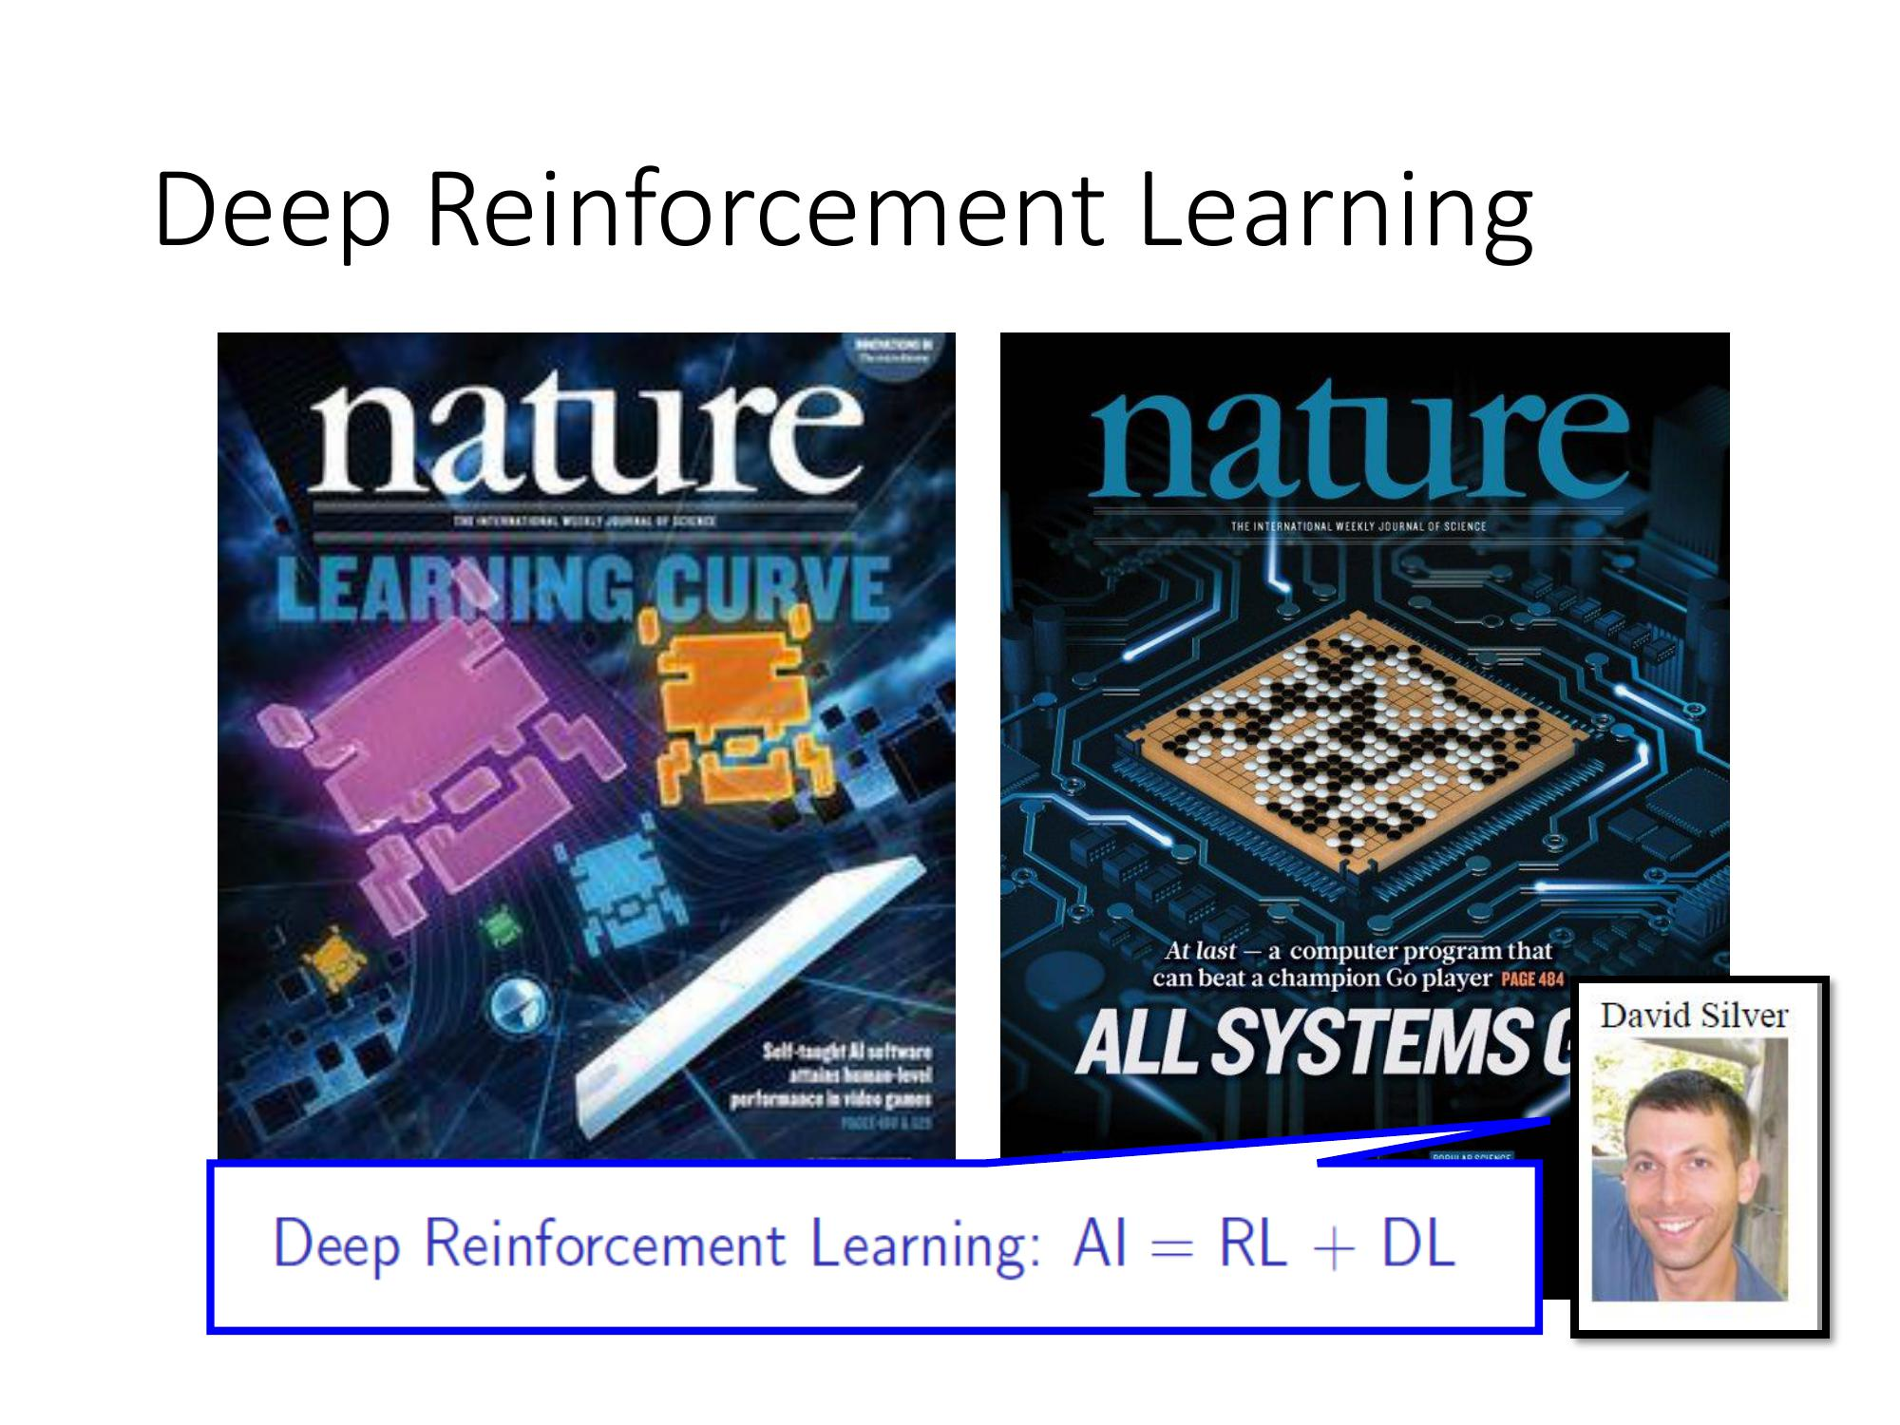
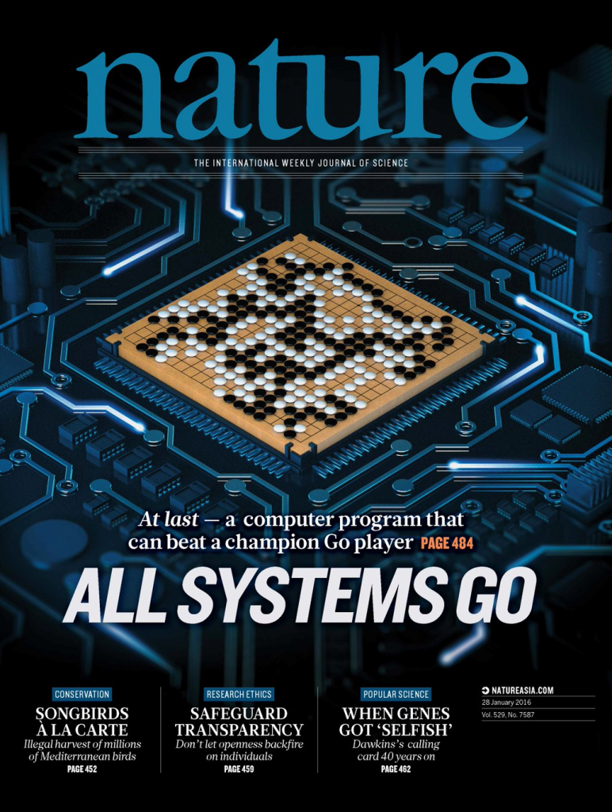
Contemporary Applications of Control Systems
A control system is a system designed to regulate or manage the behavior of other systems using feedback and control actions.
Optimization-based Control
Learning-based Control
Richard S. Sutton and Andrew G. Barto, Reinforcement Learning: An Introduction (2nd Edition, 2018)
Rawlings, J. B., & Mayne, D. Q. Model Predictive Control: Theory and Design. Nob Hill Publishing. (2009). Drgona J., et al. "All You Need to Know About Model Predictive Control for Buildings." Annual Reviews in Control, September 29, 2020
G. Dulac-Arnold, D. J. Mankowitz, and T. Hester, “Challenges of real-world reinforcement learning,”, 2019.

Slide 4
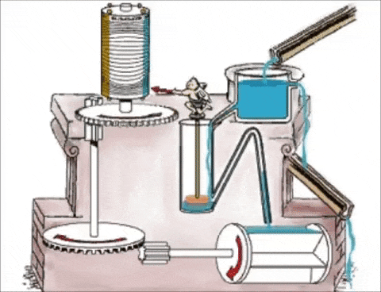
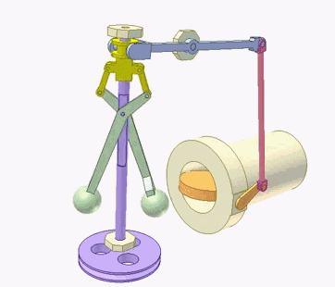
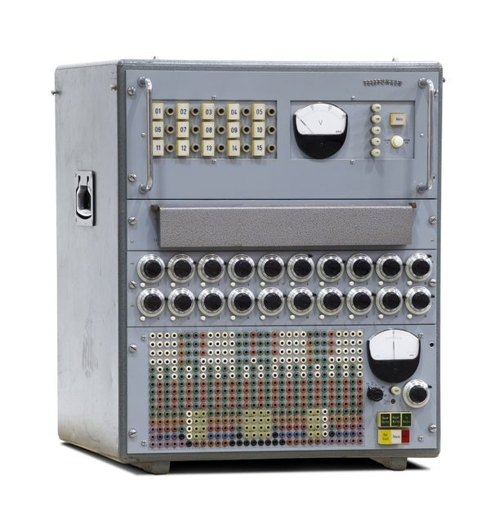
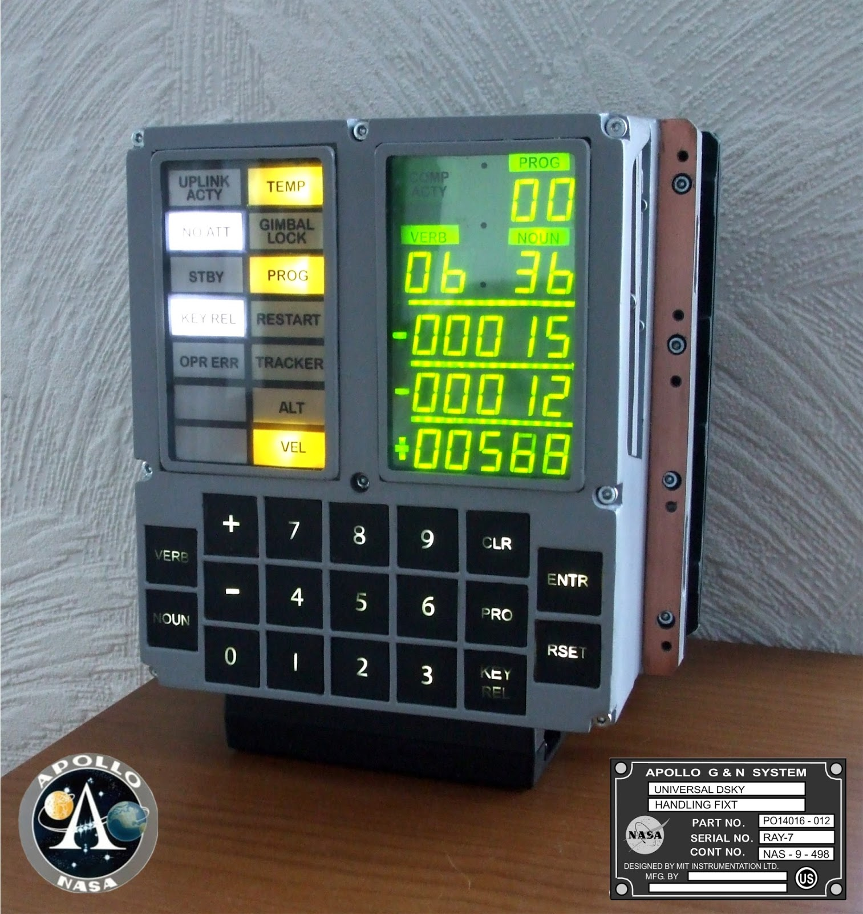
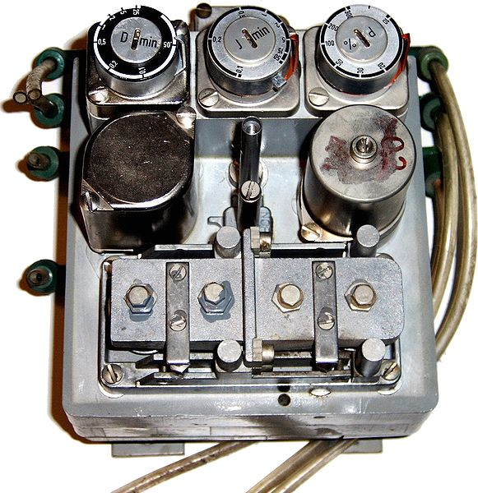
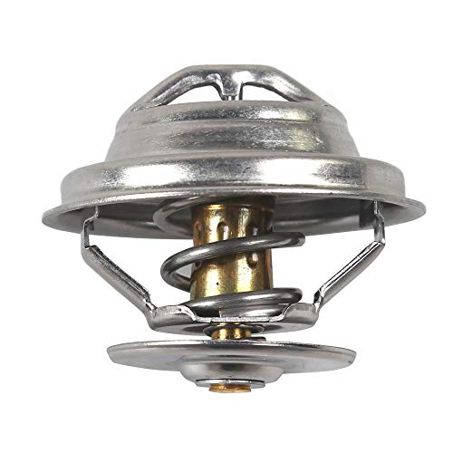
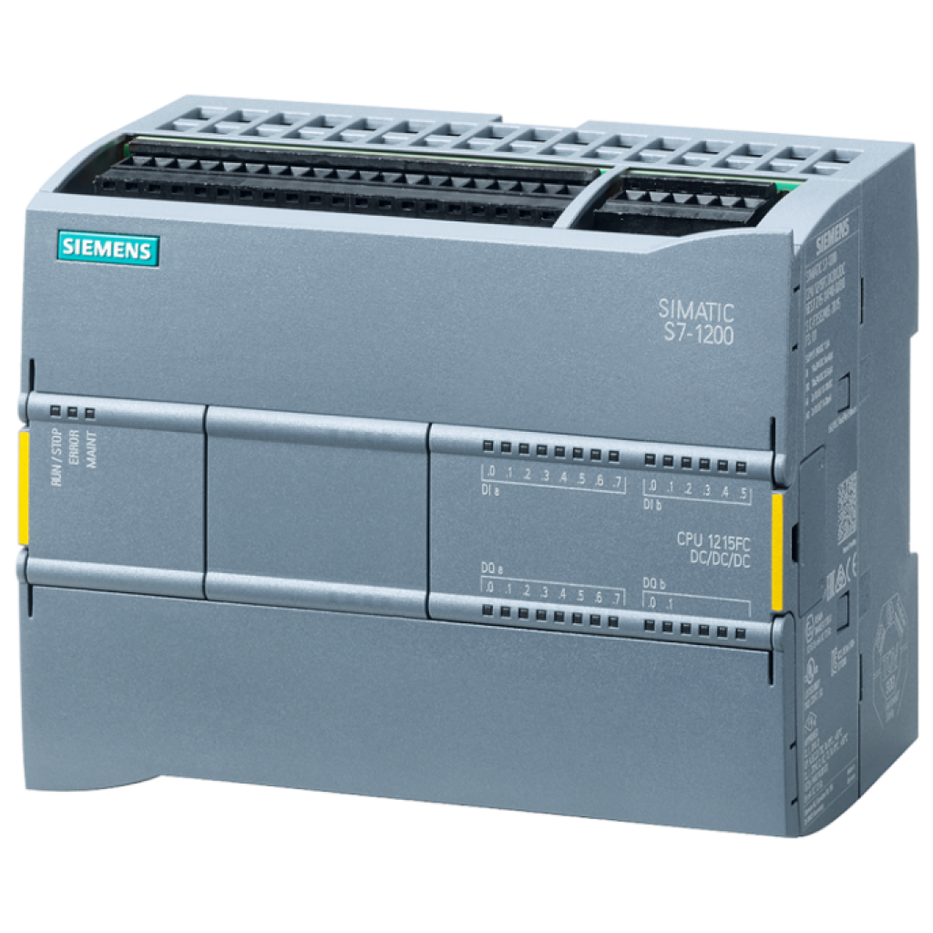
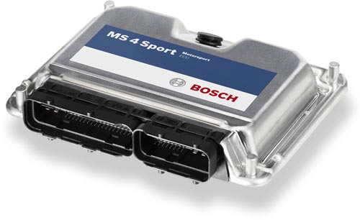
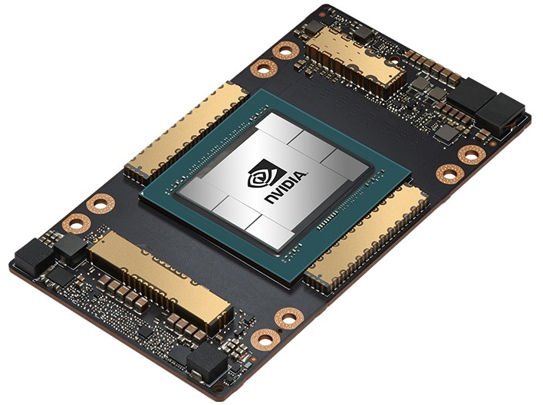
History of Control Systems
200 BCE – 1600s: Water clocks and mechanical regulators
17th century: Centrifugal governor, the first proportional controller
19th century: First electric thermostat
1800s – 1920s: Classical control theory: Fourier analysis, stability theory
1911 – 1942: Proportional Integral Derivative (PID) controllers
1930s – 1950s: Analog computing
1950s – present: Digital computing, microcontrollers, PLCs, FPGAs
1950s – 1990s: Modern control theory: state-space, Kalman Filter, LQR, robust and adaptive control
1990s – present: Contemporary optimal control and AI-based control systems

Slide 5
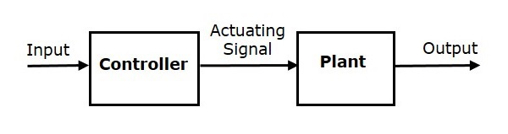
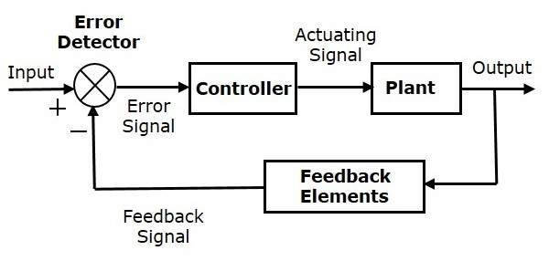
Control Systems Jargon
Controller: Algorithm that computes the control actions to manage the behavior of another system.
Controlled System: Device, plant, or process to be controlled to achieve desired behavior.
Actuator: Device that takes in a signal form the controller and carries an action to affect the system.
Sensor: Device that measures system output.
Feedback: Process of using the system’s output to influence its input to achieve desired performance.
Control error: Difference between desired and actual output response of the system.
Stability: System response converges to a fixed point or remains bounded over time.
Open-loop control system:
Closed-loop control system:
https://en.wikibooks.org/wiki/Control_Systems https://www.tutorialspoint.com/control_systems/index.htm

Slide 6
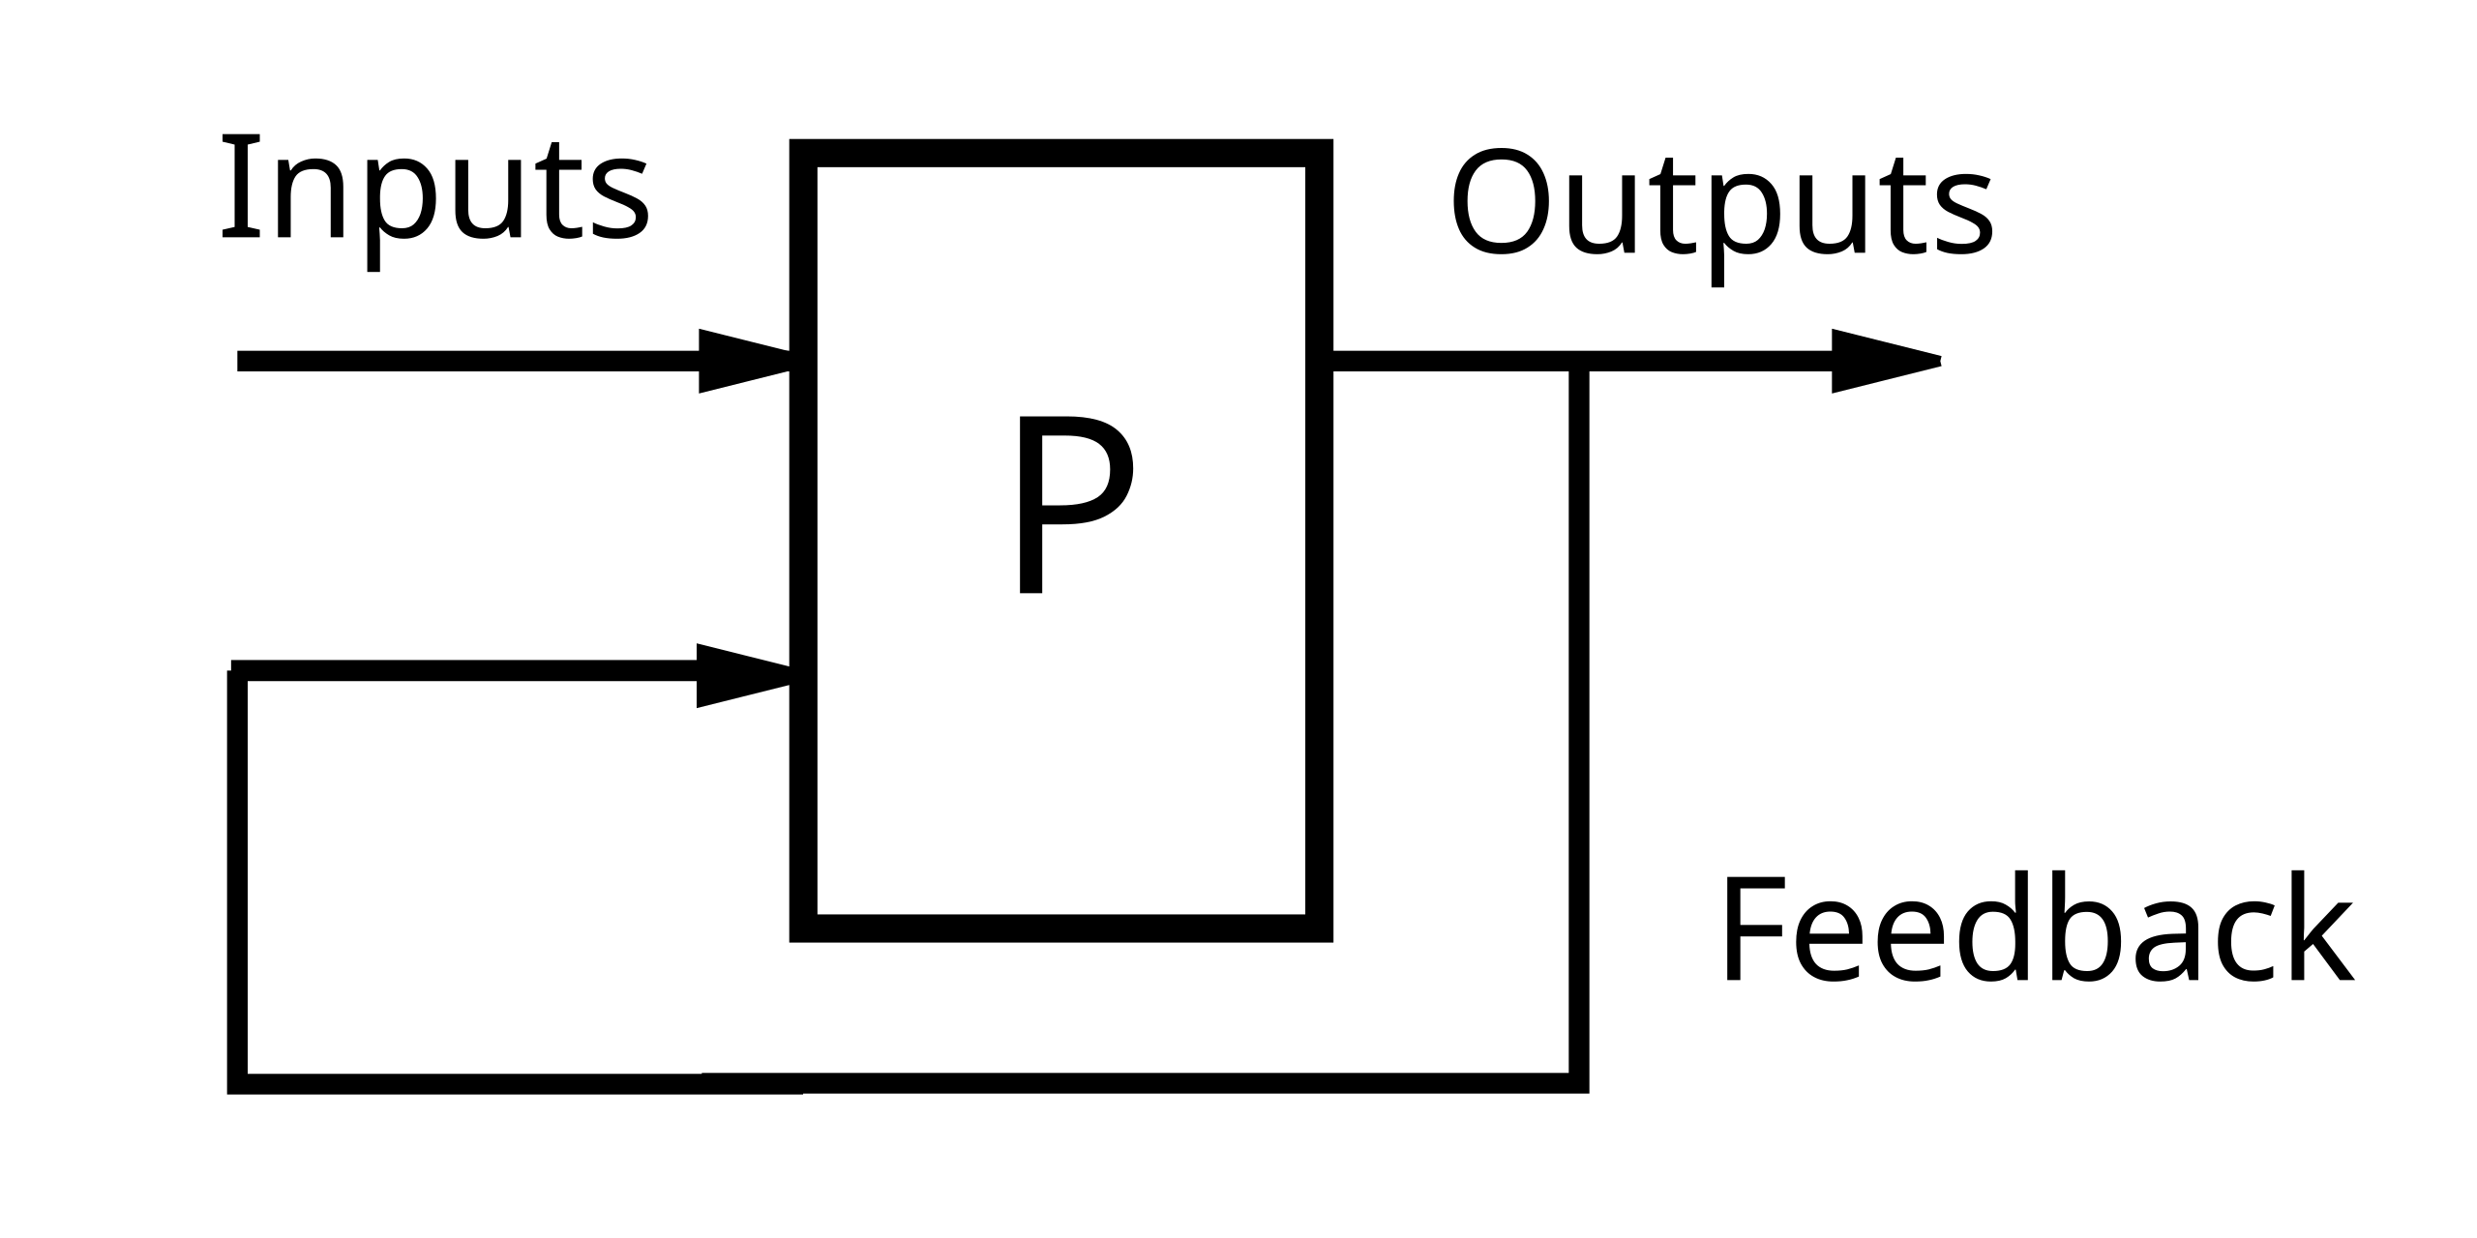
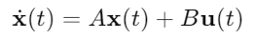
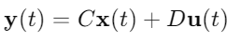
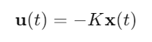
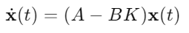
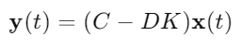
Feedback Systems
Feedback occurs when outputs of a system are routed back as inputs as part of cause-effect loop.
Can adapt to disturbances or changes in the system.
Essential for dynamic systems that need regulation.
Positive feedback: Amplifies or increases the effect of an initial disturbance or input.
Leads to exponential growth or instability.
Negative feedback: Reduces the effect of a disturbance, bringing the system back toward a desired state.
Can stabilize the system and minimize control error.
Closed-loop system: Dynamical system with feedback controller.
Control theory: Studies modeling, analysis, and design of feedback systems.
Continuous-time state space model:
Linear state feedback controller:
Closed-loop system representation:
https://en.wikipedia.org/wiki/Control_theory

Slide 7
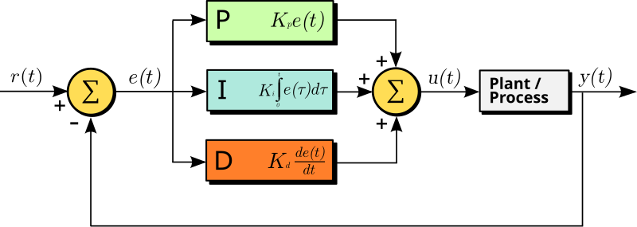
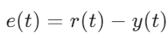
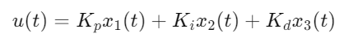
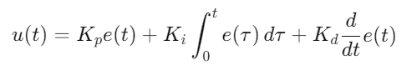
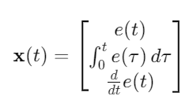
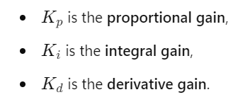
Proportional Integral Derivative (PID) Control
PID controller: a method for designing feedback for single input single output (SISO) systems aimed to minimize a control error between desired reference r(t) and output y(t) of a system.
Control error:
PID control law in state-space form:
PID control law:
Closed-loop state space system with PID:
https://en.wikipedia.org/wiki/Proportional%E2%80%93integral%E2%80%93derivative_controller

Slide 8
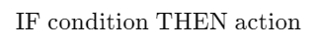
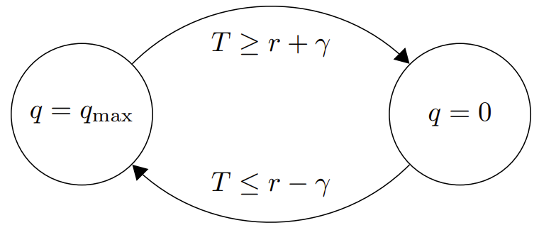
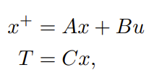
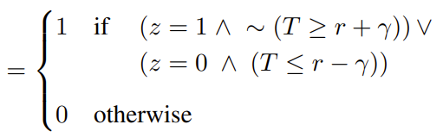
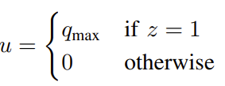
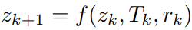
Rule-based Control (RBC) or Logic Control
RBC: is a type of control system that uses a set of predefined rules to determine the control action based on the state or conditions of the system.
Relay-based thermostat. q is the heating command, q_{max} is the maximal heating power of the heater, T denotes the controlled temperature, r is the desired temperature setpoint, and γ > 0 is half the width of the switching zone.
State-space model of thermal dynamics:
Discrete state z switching dynamic:
Control law:
https://en.wikipedia.org/wiki/Rule-based_system

Slide 9
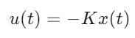
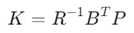
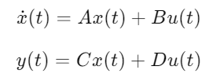
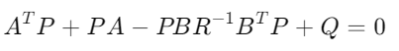
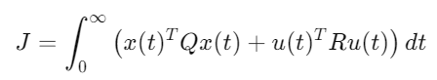
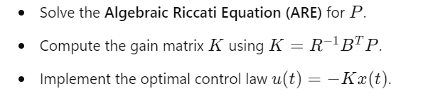
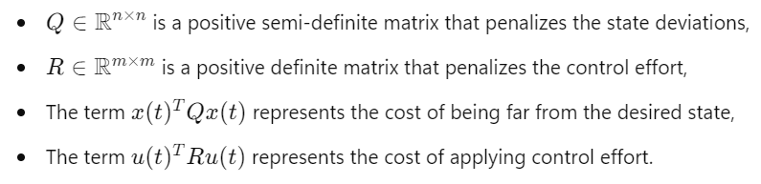
Linear Quadratic Regulator (LQR) or Who Put Man on the Moon?
LQR: is a method used to design optimal state feedback controllers for linear systems that minimizes a quadratic cost function while satisfying the dynamics of the system.
Linear state feedback control law:
The matrix K that minimizes the cost function:
State-space model system dynamics:
Where P is the solution to the Algebraic Riccati Equation (ARE):
Quadratic cost function:
Feedback design steps:
https://en.wikipedia.org/wiki/Linear%E2%80%93quadratic_regulator

Slide 10
Summary of Control Methods and System Models
Dynamical System/Plant Models:
Transfer functions
Transfer matrices
State space models
Difference equations
Differential equations
Finite state machines
Discrete hybrid automata
Machine learning models
Control Methods:
Proportional Integral Derivative (PID)
Rule-based control (RBC)
Linear Quadratic Regulator (LQR)
Model Predictive Control (MPC)
Reinforcement Learning (RL)
Adaptive control
Robust control
Fuzzy logic control
Further reading:
https://en.wikibooks.org/wiki/Control_Systems/Introduction
N. S. Nise, Control Systems Engineering (6th Ed.). Wiley. (2011).
R. Sutton and A. Barto, Reinforcement Learning: An Introduction (2nd Edition, 2018)
J. Rawlings, D. Mayne, M. Diehl, Model Predictive Control: Theory, Computation, and Design, 2022

Slide 11
Homework Assignment
Using python design a control strategy for an ODE system or a state space model of your choice. Include time series visualizations using matplotlib. Experiment with different parameters such as ODE parameters, feedback gain, PID coefficients.
Submit working .py file and a pdf document describing the code.
Examples of systems:
Lotka-Volterra Predator-Prey Model
Spring-Mass-Damper System
Double pendulum or Damped Pendulum
Heat transfer model of a house
Control methods:
PID
Bang-bang hysteresis control
LQR

Slide 12
Grading and Course Expectations
Participation 10%
Homework 30% - week 3-5
Project proposal 10% - week 6
Project progress report 10% - week 8
Project final report 20% - week 10
Project presentation 20% - week 11

